Slide 1
IST718 Credit Score Prediction with Random Forests
Willard Williamson
Adjunct Professor
iSchool, Syracuse University
linkedin.com/in/ncc-1701-d

Slide 2
Attendance
Please fill out the attendance sheet: https://docs.google.com/spreadsheets/d/1G5tiqXQn9mwyubWdINtPI_QONXH1_2U8oYikksgWlss/edit?usp=sharing
Write in a ‘1’ if you are present

Slide 3
Objectives
The Credit Score problem
Logistic regression
Decision Trees
The wisdom of the crowds
Bagged Decision Trees
Random Forest
Gradient boosting
Spark ML demo

Slide 4
The credit score problem
Predict whether someone will be in financial distress
Data from Kaggle: https://www.kaggle.com/c/GiveMeSomeCredit
Credit scoring algorithms, which make a guess at the probability of default, are the method banks use to determine whether or not a loan should be granted. This competition requires participants to improve on the state of the art in credit scoring, by predicting the probability that somebody will experience financial distress in the next two years.

Slide 5
The credit score problem (2)
Predict whether someone will be in financial distress
Data from Kaggle: https://www.kaggle.com/c/GiveMeSomeCredit
1
A measure that combines all thresholds of a decision method is the Area Under the ROC Curve (AUC)
True positive rate
Random classifier
0
1
False Positive Rate

Slide 6
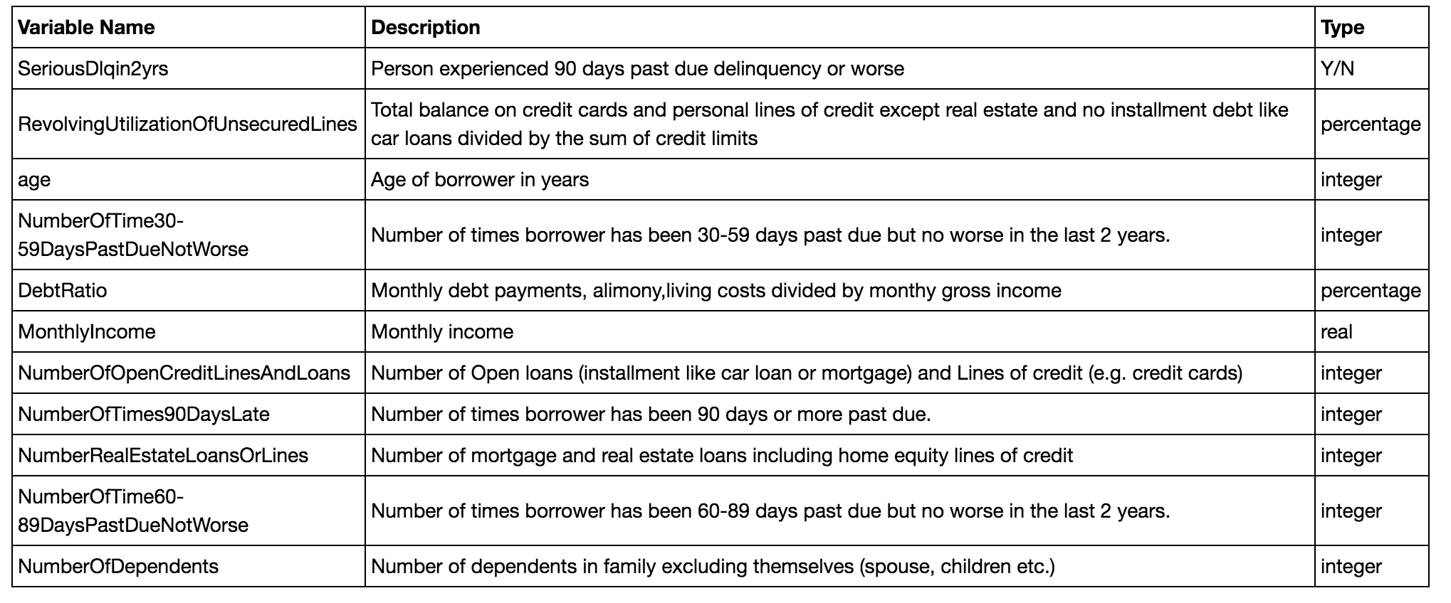
The credit score problem (3)

Slide 7
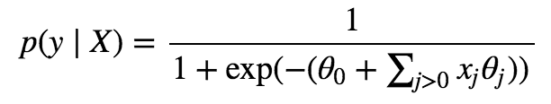
A problem with logistic regression
Remember the model we are trying to learn
What is the boundary between classes?

Slide 8

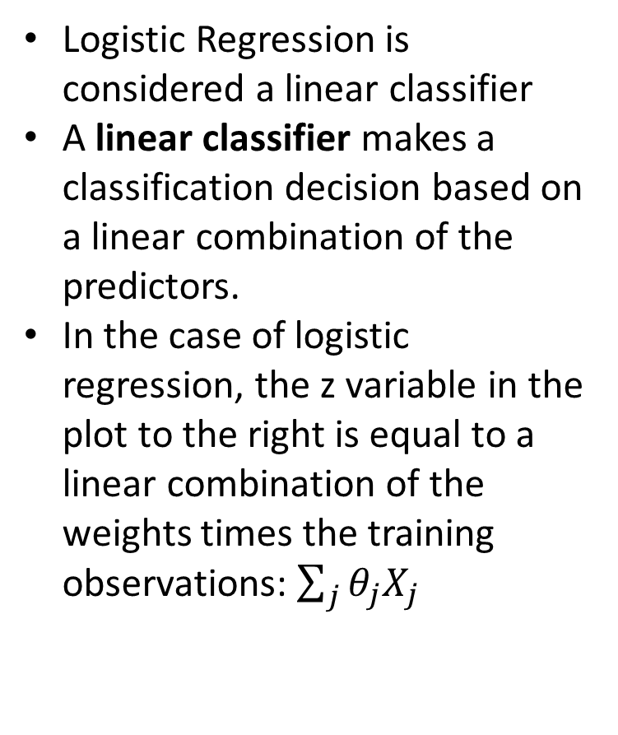
Logistic Regression Sigmoid Function
Logistic Regression is considered a linear classifier
A linear classifier makes a classification decision based on a linear combination of the predictors.
In the case of logistic regression, the z variable in the plot to the right is equal to a linear combination of the weights times the training observations: $\sum_{j}{θ_{j}X_{j}}$
https://en.wikipedia.org/wiki/Linear_classifier#Definition
https://stats.stackexchange.com/questions/93569/why-is-logistic-regression-a-linear-classifier

Slide 9
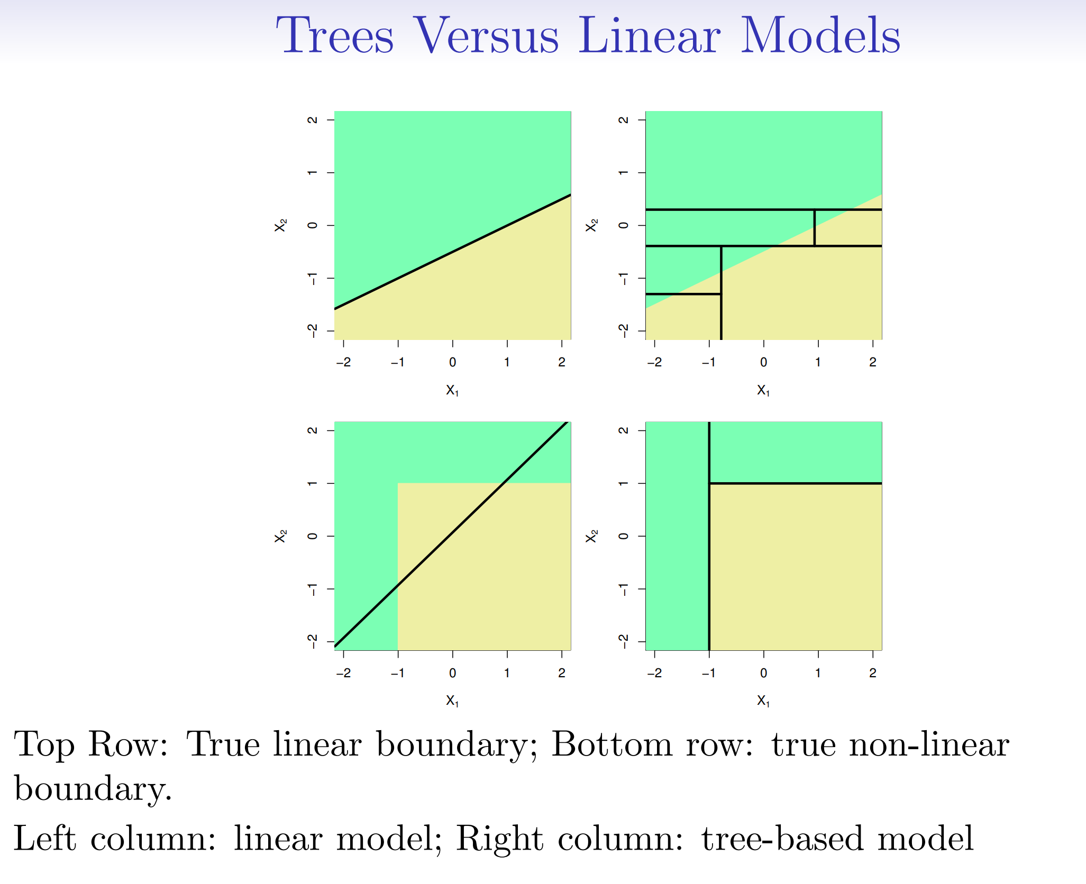
Trees vs. Linear Models
See ISLR Figure 8.7

Slide 10
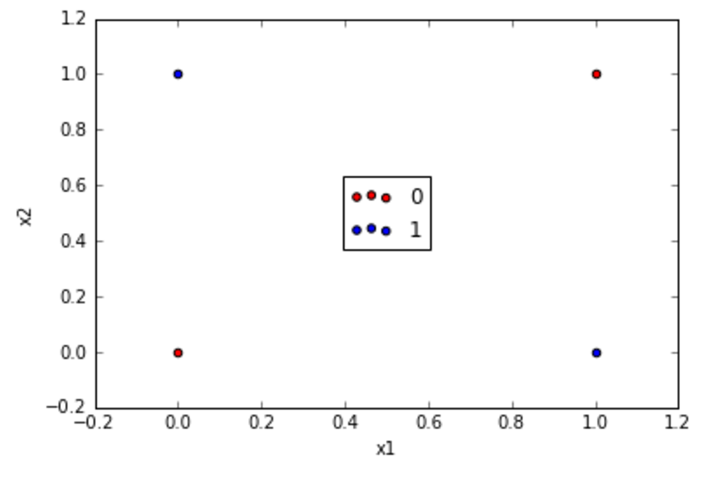
The XOR problem
Two features, two classes, and 4 data points
Can we use logistic regression to fit the exclusive-or function?
XOR Truth Table
X1 | X2 | X1 XOR X2
0 | 0 | 0
0 | 1 | 1
1 | 0 | 1
1 | 1 | 0

Slide 11
The XOR problem
Two features, two classes, and 4 data points
What can we do to the data which would make the classes linearly separable?
XOR Truth Table
X1 | X2 | X1 XOR X2
0 | 0 | 0
0 | 1 | 1
1 | 0 | 1
1 | 1 | 0

Slide 12
Decision trees
Decision tree recursively partitions the feature space.
The decisions are typically simple.
Because of the recursive partitioning, the decision can be represented as a tree.

Slide 13
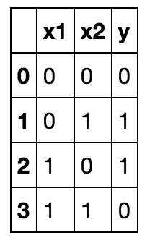
Decision trees
Propose a decision tree to fit this dataset

Slide 14
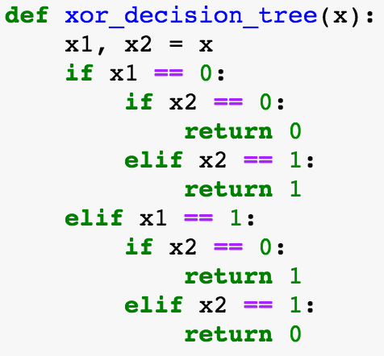
Decision trees

Slide 15
Decision trees
Recursively partition the space into M regions
R₁
R₁

Slide 16
Decision trees
Recursively partition the space into M regions
R₁
R₂
R₃
R₂
R₃

Slide 17
Decision trees
Recursively partition the space into M regions
R₁
R₄
R₃
R₂
R₃
R₅
R₄
R₅

Slide 18
Decision trees
Recursively partition the space into M regions
R₁
R₄
R₆
R₂
R₃
R₅
R₇
R₄
R₅
R₆
R₇

Slide 19
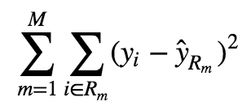
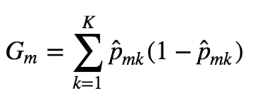
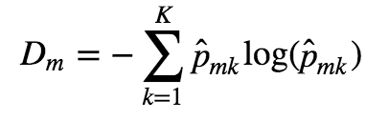
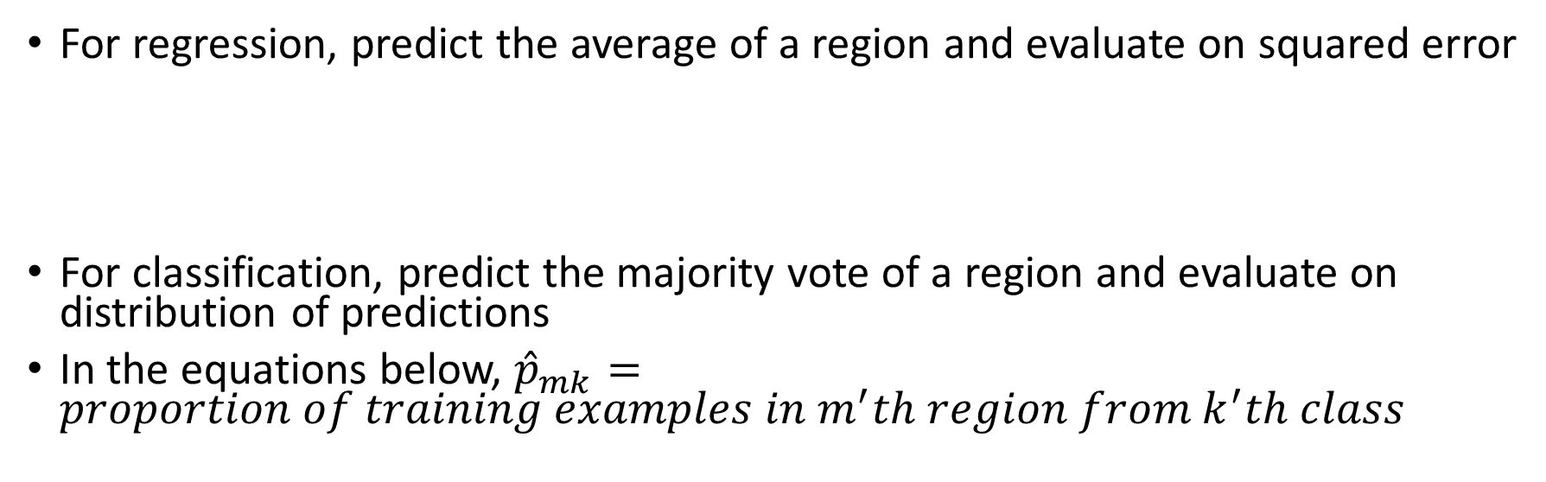
Decision tree prediction / evaluation
For regression, predict the average of a region and evaluate on squared error
For classification, predict the majority vote of a region and evaluate on distribution of predictions
In the equations below, ${\hat{p}}_{mk}=proportion of training examples in m^{′}th region from k^{′}th class$
Gini Index
Entropy

Slide 20
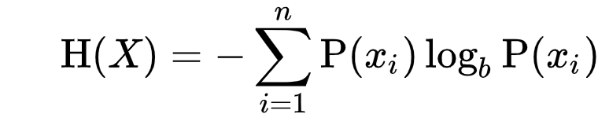
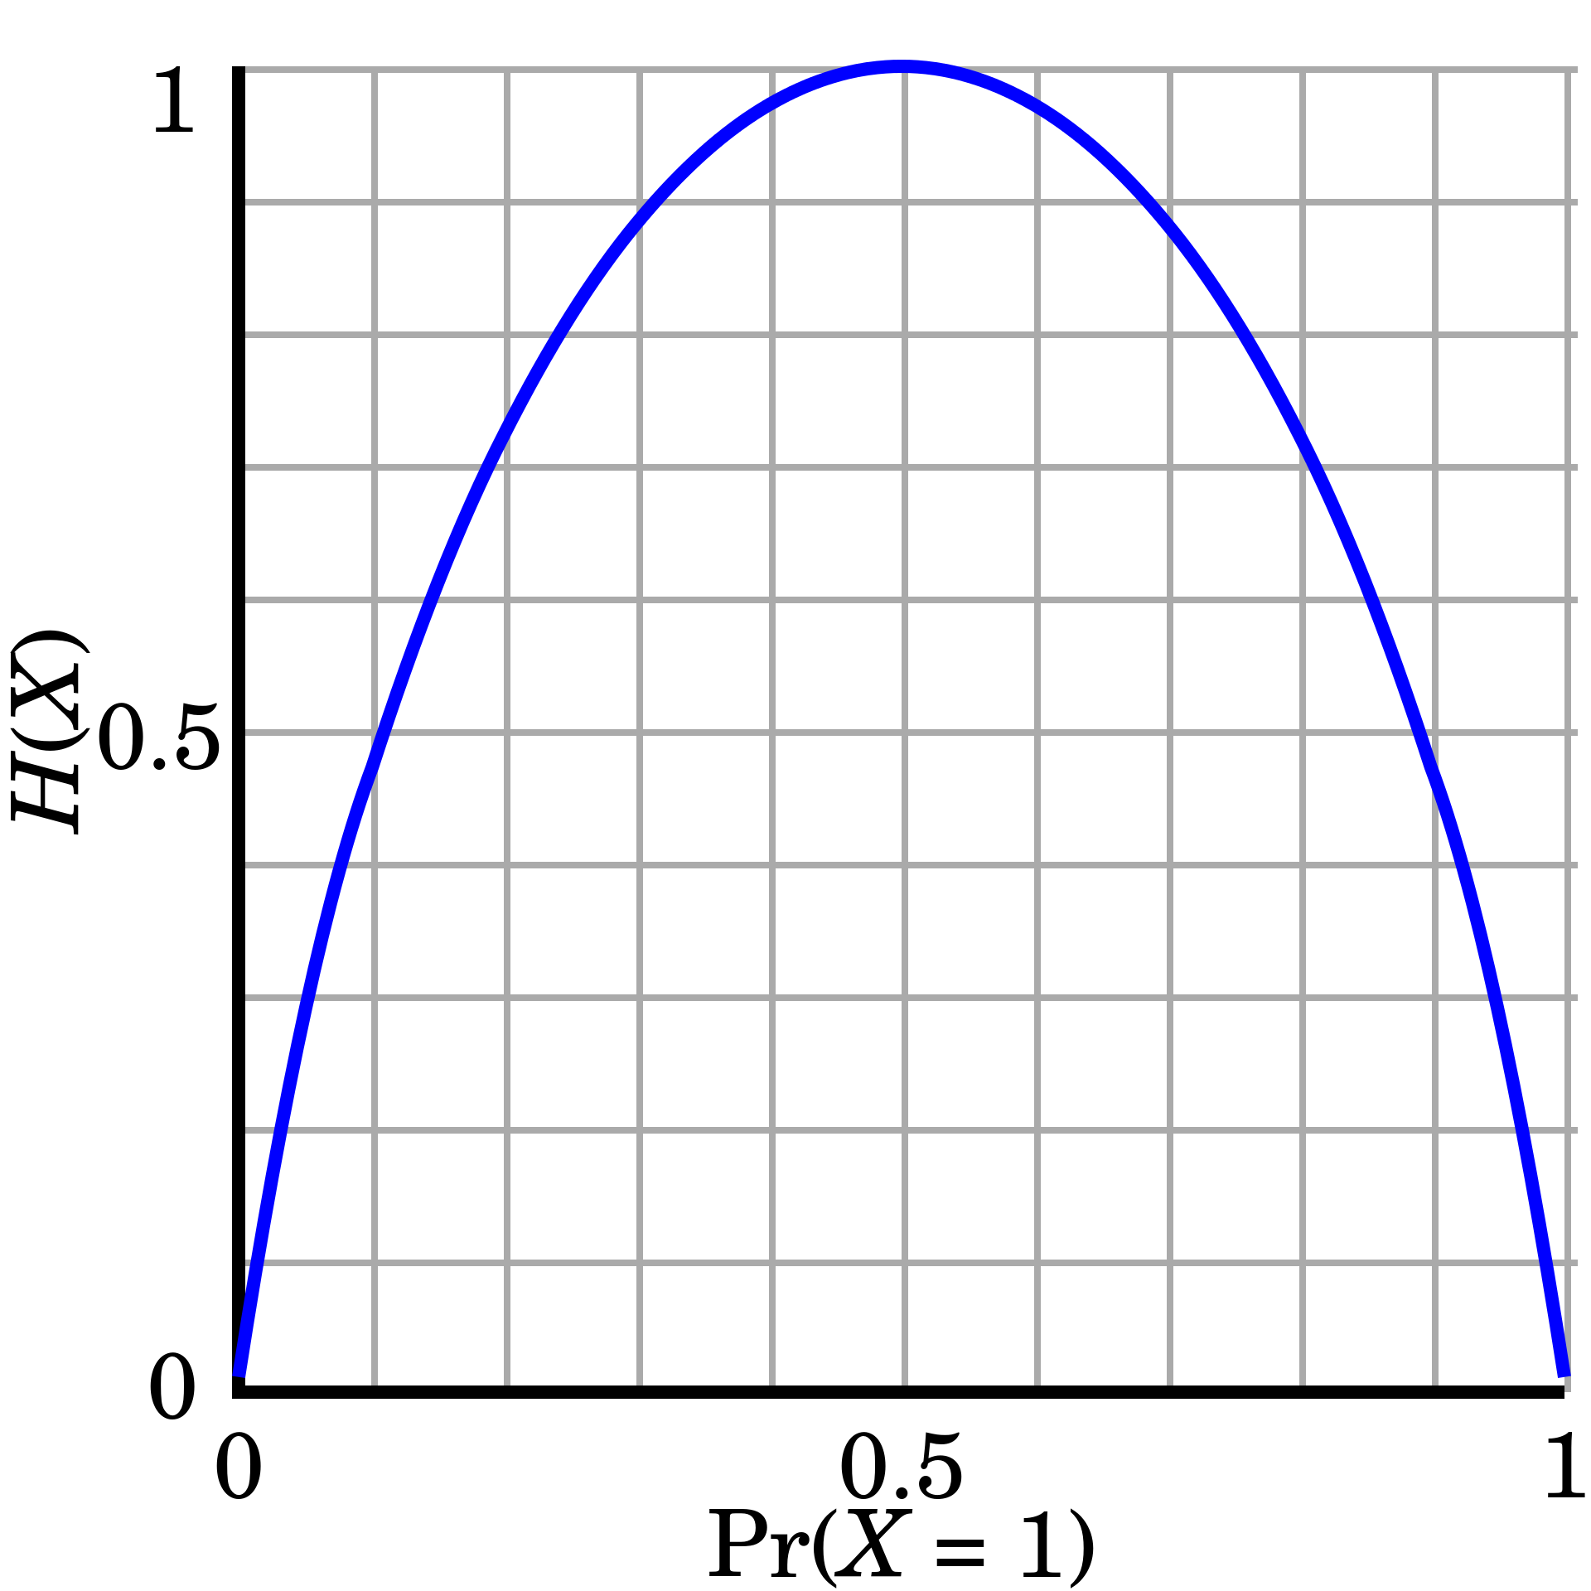
Entropy
A measure of randomness or information
Low randomness -> high information
High randomness -> low information
X axis shows probability of a binary random variable
Y axis shows a measure of randomness (entropy)
https://en.wikipedia.org/wiki/Binary_entropy_function

Slide 21
Entropy
Perfect randomness (fair coin), H(X) = 1
As we move away from perfect randomness, we “gain information” about the event
Reduction of entropy is known as information gain

Slide 22
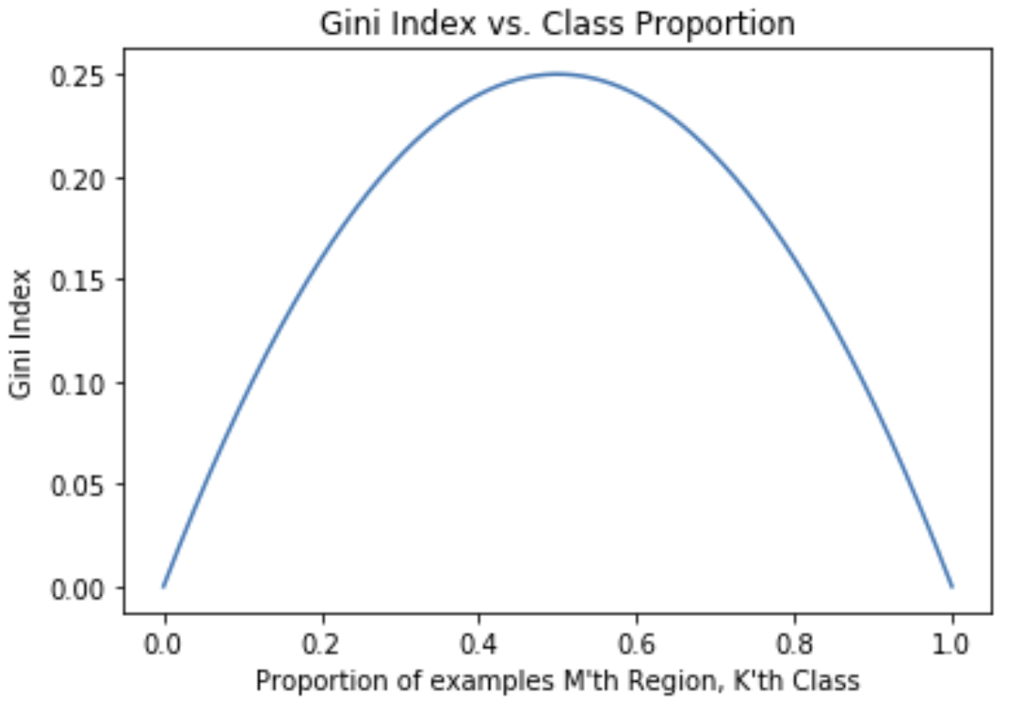
Gini Index
Gini Index
The gini index is a measure of node purity
Consider 2 classes.
If the proportion of classes is exactly 50%, the gini index is maximized
If the proportion of classes is 0% or 100%, the gini index is minimized
As the gini index decreases or increases from 0.5, a tree node contains more of the same class (less variation between classes)
The goal is to find a split that reduces the gini index

Slide 23
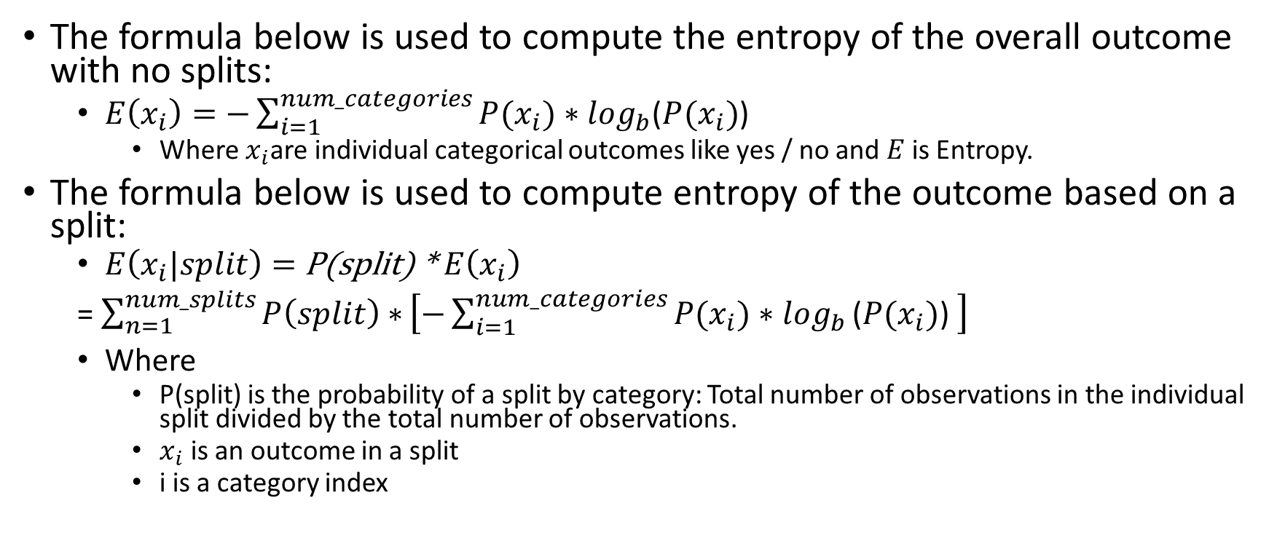
Entropy Formulas for Categorical Outcomes
The formula below is used to compute the entropy of the overall outcome with no splits:
$E\left(x_{i}\right)=−\sum_{i=1}^{num_categories}{P(x_{i})∗\log_{b}}$($P(x_{i})$)
Where $x_{i}$are individual categorical outcomes like yes / no and $E$ is Entropy.
The formula below is used to compute entropy of the outcome based on a split:
$E\left(x_{i}|split\right)=$ P(split) * $E\left(x_{i}\right)$
= $\sum_{n=1}^{num_splits}{P\left(split\right)∗}\left[−\sum_{i=1}^{num_categories}{P(x_{i})∗\log_{b}}\text{(}P(x_{i})\text{) }\right]$
Where
P(split) is the probability of a split by category: Total number of observations in the individual split divided by the total number of observations.
$x_{i}$ is an outcome in a split
i is a category index

Slide 24
Information Gain
Information gain is the expected reduction in entropy caused by partitioning the outcomes using one of the predictors.
Summary: Info Gain = H(S, a) = H(S) – H(S | a)
Where
H = Entropy
S = Dataset
a = Specific variable in dataset S
H(S,a) = Information gain
H(S) = Entropy of unpartitioned data
H(S|a) = Entropy of data after splitting or partitioning the data on predictor

Slide 25
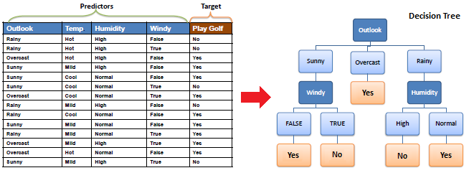
Classification Decision Tree Tutorial
This and the following slides refer to the following tutorial:
https://www.saedsayad.com/decision_tree.htm

Slide 26
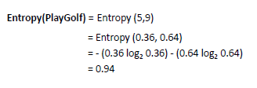
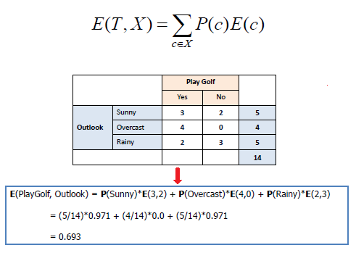
Classification Tree Tutorial
Top Right: The entropy of ‘play golf’ in the original data is 0.94 – almost perfectly random
Top Right: 0.36 = #no / total = 5/14
Top Right: 0.94 = #yes / total = 9/14
In the equation at the right, T is the outcome column (play golf), X column to split on, P(c) is the prob(individual category in col X), E(c) is the entropy of an individual category in col X.
Bottom Right: If we split the data on ‘outlook’, the resulting entropy of ‘play golf’ is 0.693

Slide 27
Classification Tree Tutorial
In the calculations at the bottom:
P(Sunny Split) = 5/14
P(overcast Split) = 4/14
P(rainy split) = 5/14)
E(Sunny) = E(Rainy) = .971
E(overcast) = 0
The information gain is 0.94 – 0.693 = .247
Splitting play golf on outlook resulted in an information gain

Slide 28
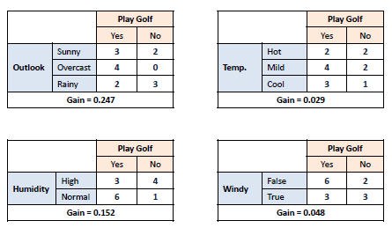
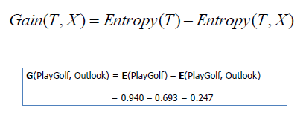
Classification Tree Tutorial
Splitting Process:
Calculate the entropy of ‘play golf’ by itself
Calculate the entropy of play golf split on outlook, temp, humidity, and windy.
Calculate the information gain of each split
Choose the split which produces the biggest information gain (outlook)

Slide 29
Feature Selection Inference
Note that the process of calculating the information gain is akin to feature selection
The feature split that produces the most gain is the “most important”
Feature splits towards the top of the tree are the most important

Slide 30
See the following for more information
https://machinelearningmastery.com/what-is-information-entropy/
https://machinelearningmastery.com/information-gain-and-mutual-information/

Slide 31
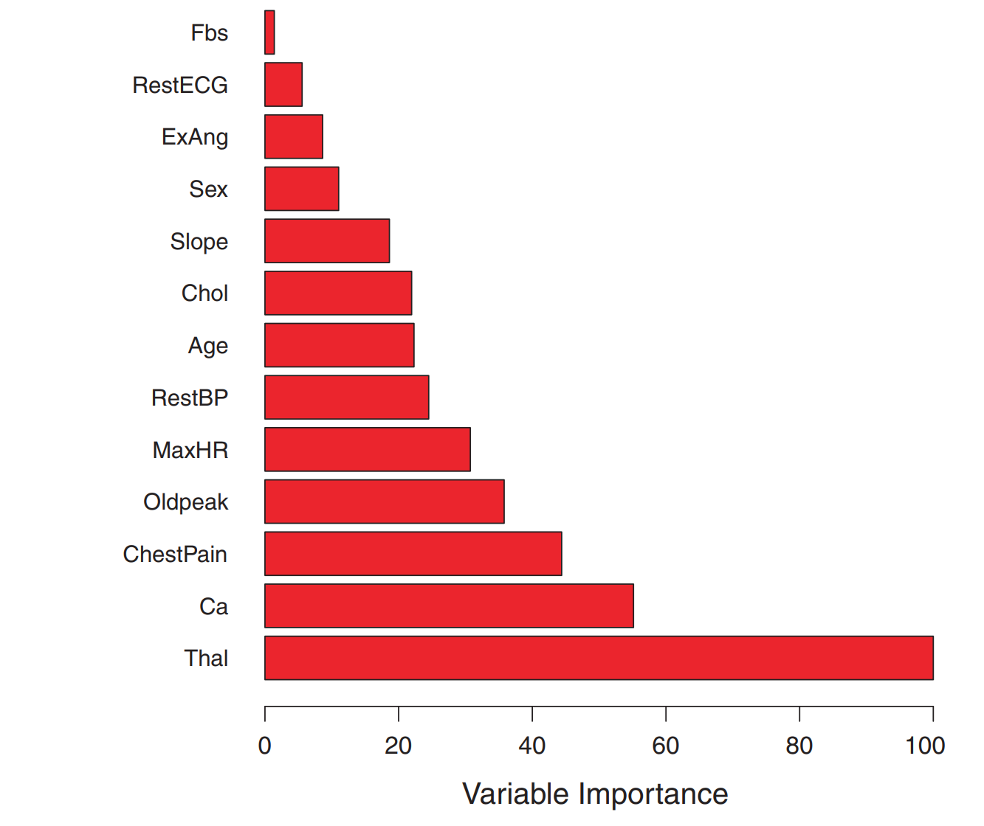
Sample Feature Importance: ISLR Figure 8.9
Variable importance was computed using the mean decrease in the gini index for the heart data set
In some cases, decision tree feature importance can be used to select features to use in models that don’t have robust feature selection capability (like deep learning)
The plot at the right shows that Thal, Ca, and ChestPain are the top 3 most important variables
The variable importance plot at the right show the importance's relative the largest (Thal)

Slide 32
Prediction
Start at the root of the tree (top) with an unseen example to make a prediction
Follow the tree decisions to a leaf node
In the case of regression, compute the average value of training examples in the leaf node. The average value of the values in the leaf node will be the predicted value
In the case of classification, the majority vote of the classes in the leaf node will be the predicted value

Slide 33
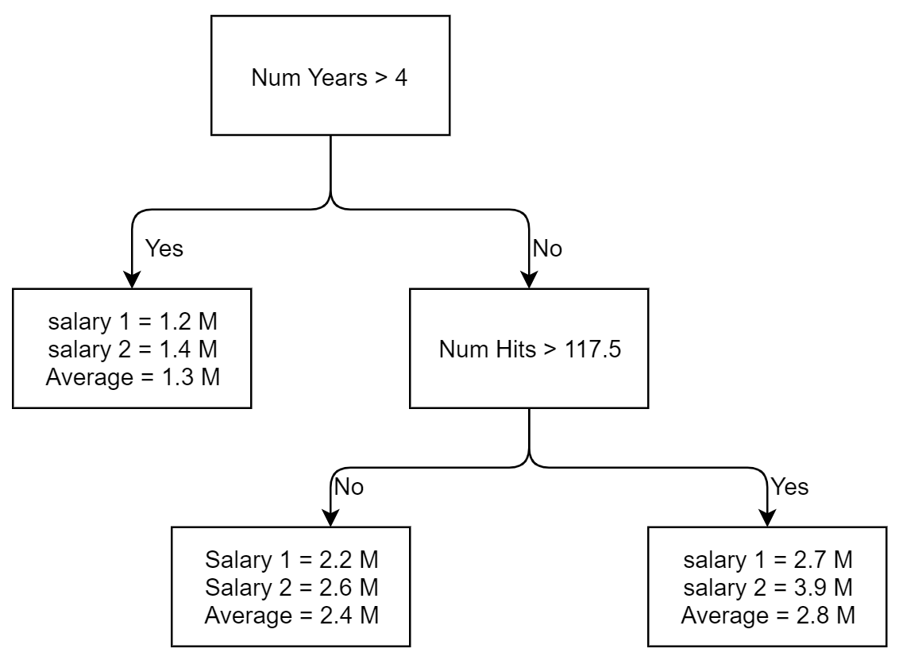
Baseball Salary Regression Prediction Example
Input Data: num years = 3, num hits = 110
Follow root to the right child because num years < 4
Follow num hits node output to the left because num hits < 117.5
Predict salary = 2.4 M because the average salary in this leaf node is 2.4 M

Slide 34
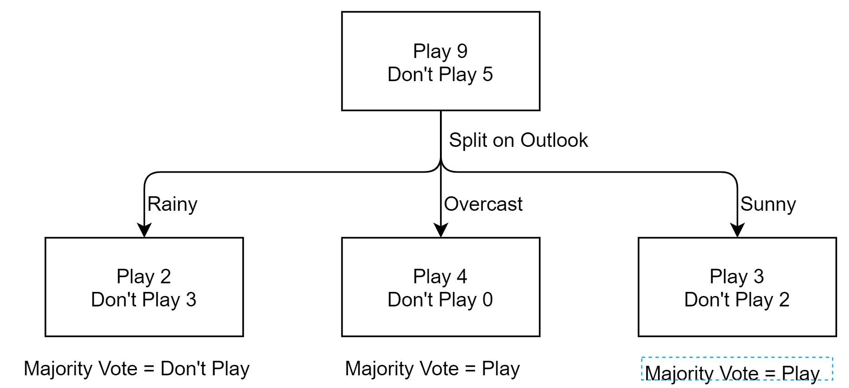
Play Golf Classification Prediction Example
Start with input data observation sunny
Follow the decision process to the bottom right leaf node
The majority is play (play = 3, don’t play = 2). Predict ‘play’.

Slide 35
Biggest problems with decision trees?
Overfitting
High Variance

Slide 36
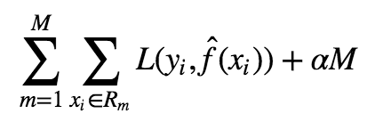
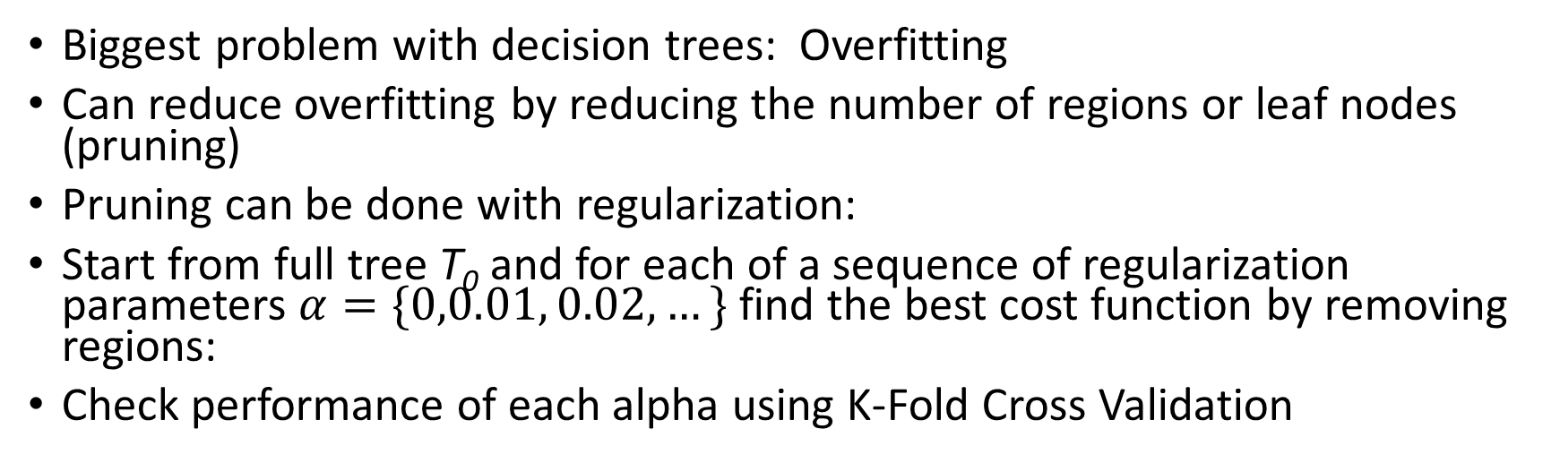
Reduce Overfitting Through L1 Regularization
Biggest problem with decision trees: Overfitting
Can reduce overfitting by reducing the number of regions or leaf nodes (pruning)
Pruning can be done with regularization:
Start from full tree T₀ and for each of a sequence of regularization parameters $α=\{0,0.01, 0.02,…\}$ find the best cost function by removing regions:
Check performance of each alpha using K-Fold Cross Validation
Loss function
Penalize trees with many regions

Slide 37
Decision Tree Pros and cons
Pros:
Easy to understand
Trees mirror human decision-making
Trees can be displayed graphically
Trees handle qualitative predictors without the need to create dummy variables.
Trees inherently provide feature importance
Cons
Plain trees (not random forest for example) have lower predictive accuracy than some of the other regression and classification approaches
High variance: A small change in the data can cause a large change in the final estimated tree

Slide 38
Bagging: Bootstrap Aggregation
Problem with decision trees is that they have high variance
One solution is to average the prediction of several trees using different datasets created by sampling the original dataset
Why would this work?

Slide 39
Wisdom of the crowd
Imagine you ask B individuals their opinion about the height of someone.
Suppose that each of them have the same variance v
What would happen to the variance of the average opinion?

Slide 40
Wisdom of the crowds
If opinions about height are normally distributed with variance v
The average of B opinions will have variance v/B
Example with a variance of 10 inches per individual in the crowd

Slide 41
Bootstrap Sampling
Bootstrap sampling is the process of sampling with replacement
A collection of observations drawn from a population is a sample
Every time an observation is drawn from a population, the observation is returned to the population
The process of sampling with replacement means that a bootstrap sample can have multiple instances of the same observation from the population

Slide 42
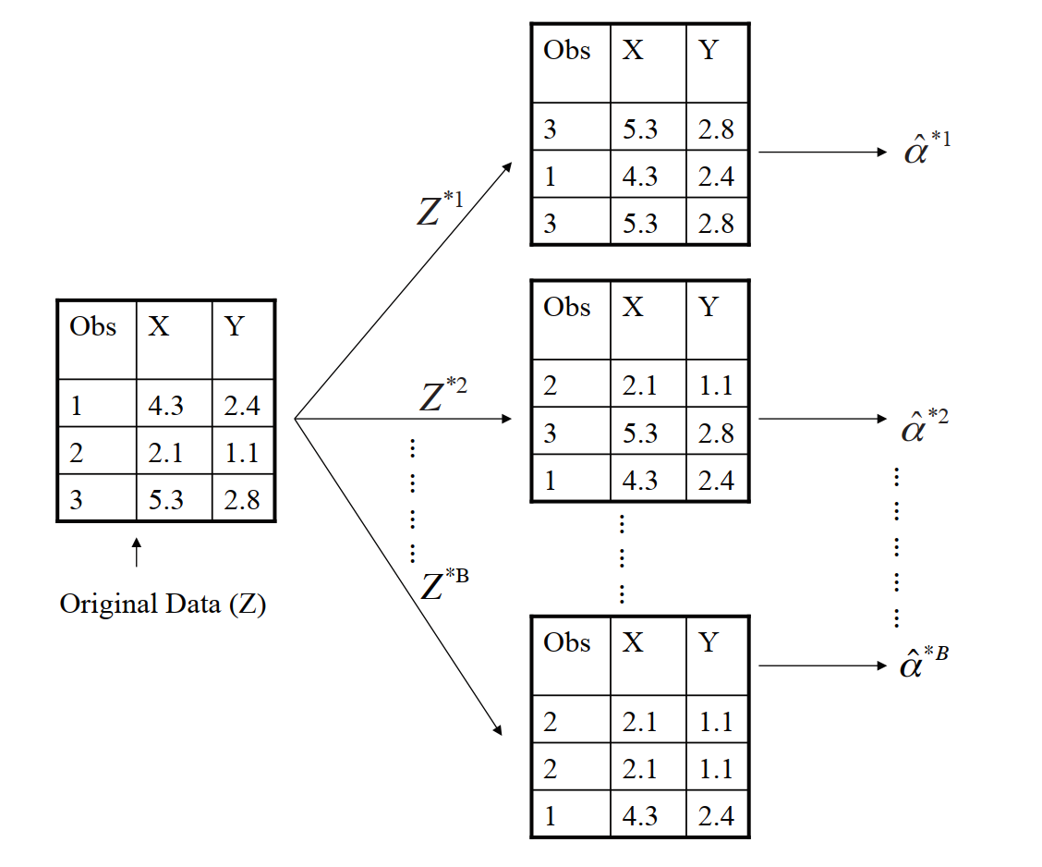
Bootstrap Example with 3 Observations
ISLR Figure 5.11

Slide 43
Bootstrap Sampling
The number of unique observations in a bootstrap sample on average will be approximately 2/3 of the number of observations in the population we are sampling.
The number of observations in the bootstrap sample is by definition always equal to the number of observations in the population
Example, number of rows in training data = 100. We wish to create a bootstrap sample.
Draw 100 observations with replacement creating a bootstrap sample
Approximately 66 of the 100 bootstrap observations are unique

Slide 44
Out of Bag Observations
Since a bootstrap sample is only expected to contain approximately 66% unique observations from the population, the other 33% are called “out of bag” samples.
Example from the previous slide, the approximately 33 observations from the population which are NOT included in the bootstrap sample are called the out of bag samples
The observations that do not make it into the bootstrap sample are called out of bag observations and can be conveniently used for model validation saving the overhead of K-Fold cross validation
Can you identify the out of bag samples from the bootstrap example with 3 observations slide above

Slide 45
Bagging
In bagging, we simulate training datasets by aggregating multiple bootstrap samples

Slide 46
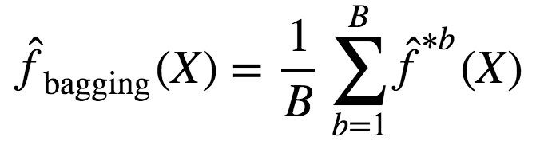
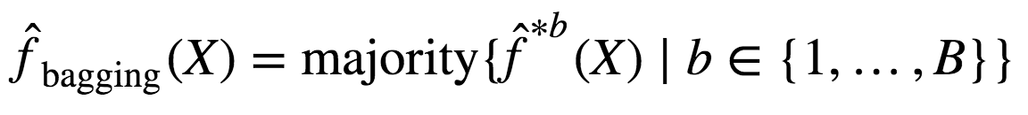
Tree Bagging
Fit a unique decision tree to each bootstrapped data sample
Average the predictions of the models and therefore reduce variance
Regression
Classification

Slide 47
Performance Estimation
In bagging, test error can be calculated using out of bag samples
Remember, each data point has approximately 1/3 chance of NOT being included in the bootstrap sample
We can use the out of bag (OOB) data points for testing performance

Slide 48
Limitations of bagging
Because we use the same training data over and over, trees become correlated
What happens to correlation in wisdom of the crowds?
If I take the average opinion as my prediction, how should I predict the results of the election?:
Independent opinions: I take each of you outside and I ask you who will win the election
Correlated opinions: I ask each of you in front of the class

Slide 49
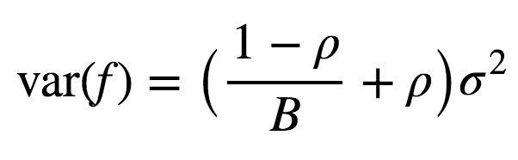
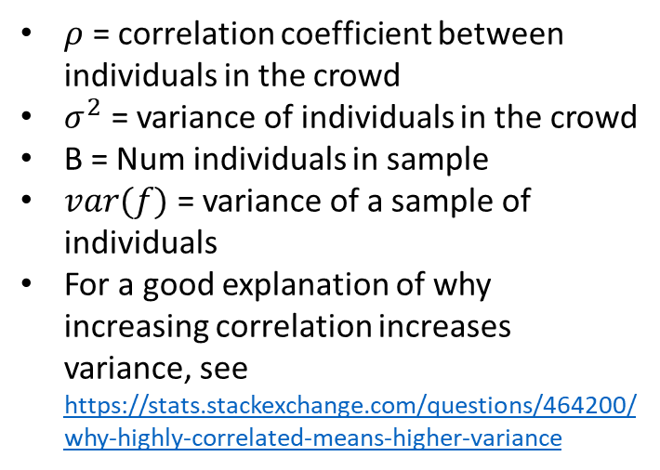
Correlations ruin bagging
Variance of estimator with correlations
$ρ$ = correlation coefficient between individuals in the crowd
$σ^{2}$ = variance of individuals in the crowd
B = Num individuals in sample
$var(f)$ = variance of a sample of individuals
For a good explanation of why increasing correlation increases variance, see https://stats.stackexchange.com/questions/464200/why-highly-correlated-means-higher-variance

Slide 50
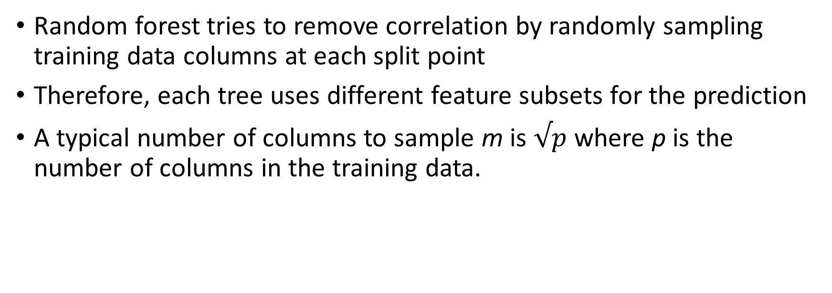
Random Forest Random Column Sampling
Random forest tries to remove correlation by randomly sampling training data columns at each split point
Therefore, each tree uses different feature subsets for the prediction
A typical number of columns to sample m is $√p$ where p is the number of columns in the training data.

Slide 51
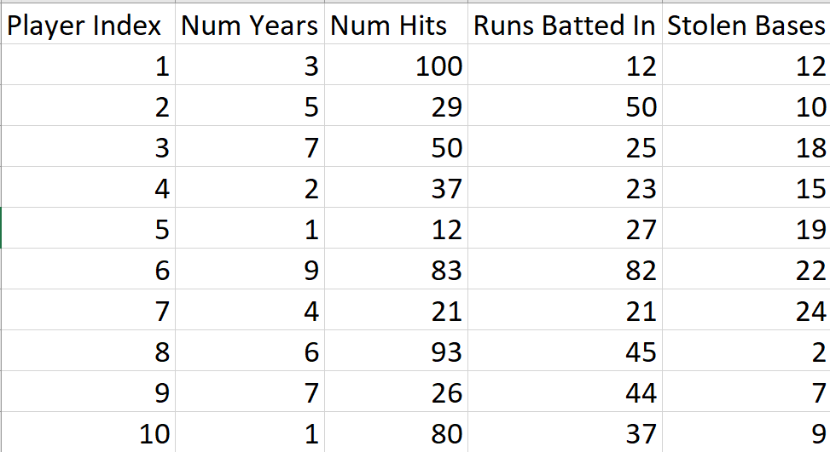
Random Forest Random Column Sampling
Sample baseball data set with 4 columns
m is a model hyper-parameter
A typical good m = sqrt(num cols) = 2

Slide 52
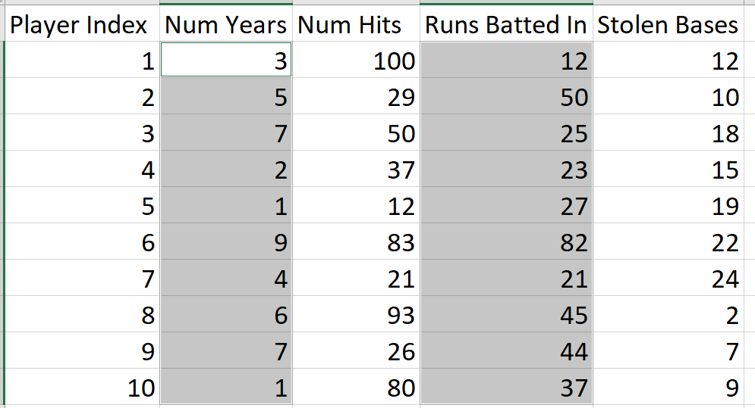
Random Forest Random Column Sampling
Since m=2, select 2 columns at random from the bootstrap sample to split the first node in the tree

Slide 53
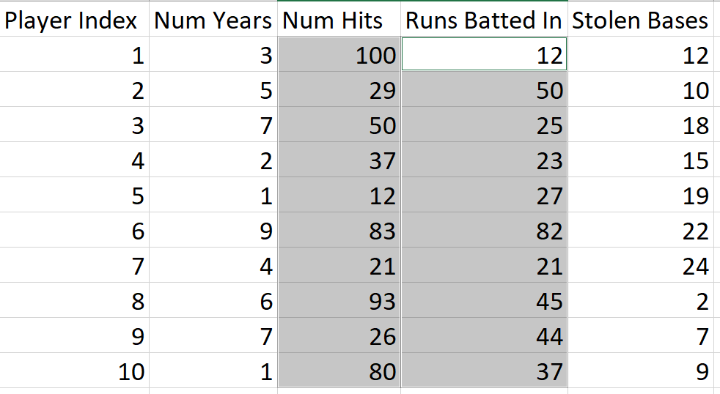
Random Forest Random Column Sampling
At the next split, pick 2 more columns at random

Slide 54
Random Forest: Putting it all together
Start with a training data set
Take n bootstrap samples where n is equal to the desired number of trees in the forest
For each bootstrap sample, grow a decision tree by sampling m columns of the bootstrap sample at each decision point
Prediction is determined by the average outcome (regression) or majority vote (classification) of the forest of predictors

Slide 55
Sample Spark Random Forest Hyper Parameters
featureSubsetStrategy = Param(parent='undefined', name='featureSubsetStrategy', doc="The number of features to consider for splits at each tree node. Supported options: 'auto' (choose automatically for task: If numTrees == 1, set to 'all'. If numTrees > 1 (forest), set to 'sqrt' for classification and to 'onethird' for regression), 'all' (use all features), 'onethird' (use 1/3 of the features), 'sqrt' (use sqrt(number of features)), 'log2' (use log2(number of features)), 'n' (when n is in the range (0, 1.0], use n * number of features. When n is in the range (1, number of features), use n features). default = 'auto'")impurity: The information gain calculation - gini, entropy
maxBins = Param(parent='undefined', name='maxBins', doc='Max number of bins for discretizing continuous features. Must be >=2 and >= number of categories for any categorical feature.')maxDepth: Maximum number of splits in the tree

Slide 56
Sample Spark Random Forest Hyper Parameters
numTrees = Param(parent='undefined', name='numTrees', doc='Number of trees to train (>= 1).’)
minInstancesPerNode = Param(parent='undefined', name='minInstancesPerNode', doc='Minimum number of instances each child must have after split. If a split causes the left or right child to have fewer than minInstancesPerNode, the split will be discarded as invalid. Should be >= 1.’)
impurity = Param(parent='undefined', name='impurity', doc='Criterion used for information gain calculation (case-insensitive). Supported options: entropy, gini')

Slide 57
Boosting Machines
Gradient boosting learns new models based on what was not learned before.
Theory is deep – outside of the scope of the course – but
Boosting is the concept of combining multiple weak learners (e.g., barely better than chance) into a strong learner.
Bagging aims to reduce variance
Boosting aims to reduce bias

Slide 58
GBM
Typically, very small trees called “stumps” are used in a GBM forest
Each stump is a weak learner
Each stump classifies only slightly better than a random guess

Slide 59
GBM
Random Forest grows a forest of trees in parallel where trees don’t depend on each other
GBM grows a forest of trees where each tree is grown serially one after the other and each subsequent tree depends on the previous trees
Start by growing a stump and using the training data to calculate the error
Error is the difference between the true and predicted outcomes
A fraction of the error from the previous tree is then used as the outcome column to grow the next tree in the forest

Slide 60
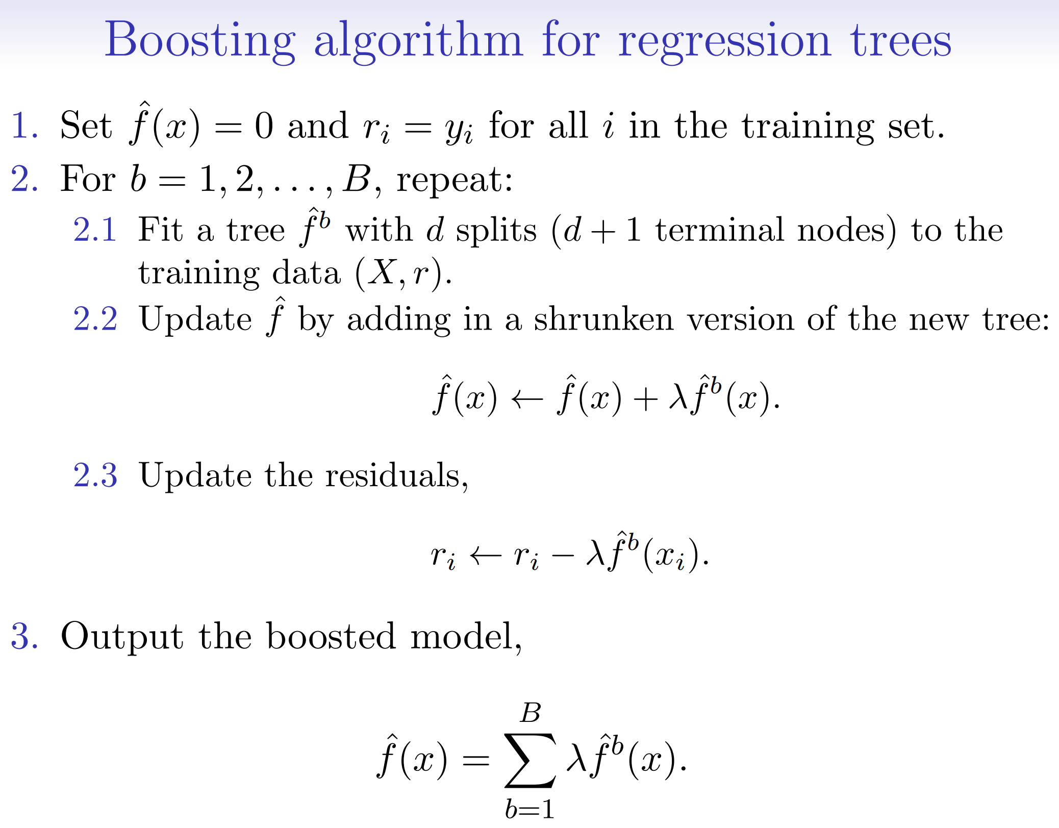
GBM: ISLR Algorithm 8.2

Slide 61
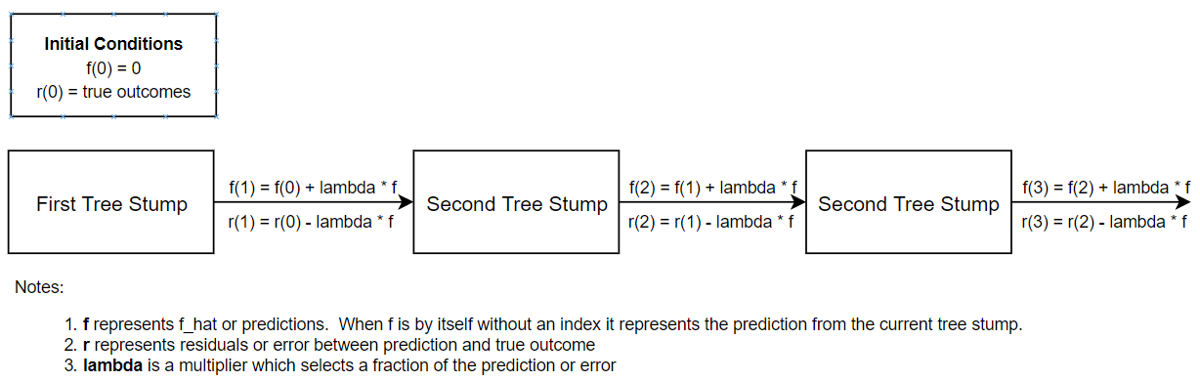
GBM Block Diagram

Slide 62
GBM Tutorial
The following web site has an interesting GBM tutorial where the author rolls his own GBT code:
https://medium.com/mlreview/gradient-boosting-from-scratch-1e317ae4587d
The visualizations show
Predictions slowly improve
Residuals slowly reduce towards zero

Slide 63
Lambda (Shrinkage) Tuning Parmaeter
Note that the shrinkage parameter lambda selects a fraction of the current tree.
A smaller lambda means the model learns slower.
Slower learning generally produces better generalization performance
Rule of thumb: 0 < Lambda < 0.125
If the shrinkage parameter lambda = 0.01, need to grow 100 trees to reach the equivalent of 1 tree.
See: https://machinelearningmastery.com/configure-gradient-boosting-algorithm/

Slide 64
Number of Trees Tuning Parameter
Number of trees works in combination with the shrinkage parameter lambda.
If lambda == 0.1, we need to grow 10 trees to reach the equivalent of one tree
The optimum lambda and number of trees are inversely proportional to each other
Rule of thumb: 100 < num_trees < 500
One grid search strategy is to simply set the number of trees to a large number like 1000 and then terminate when the marginal loss improvement is less than a threshold.

Slide 65
Tree Depth Tuning Parameter
GBM works best with weak learners
Increasing tree depth leads to stronger learners / higher variance / more complexity
It’s counter intuitive but stronger learners degrade overall model performance
Rule of thumb: Set depth between 2 and 8

Slide 66
Sample GBM Tuning Parameters
maxIter = Param(parent='undefined', name='maxIter', doc='max number of iterations (>= 0).’). Defaults to 20.
stepSize = Param(parent='undefined', name='stepSize', doc='Step size to be used for each iteration of optimization (>= 0).’). Defaults to 0.1.

Slide 67
Sample GBM Tuning Parameters
validationIndicatorCol = Param(parent='undefined', name='validationIndicatorCol', doc='name of the column that indicates whether each row is for training or for validation. False indicates training; true indicates validation.’
lossType = Param(parent='undefined', name='lossType', doc='Loss function which GBT tries to minimize (case-insensitive). Supported options: logistic')
validationTol = Param(parent='undefined', name='validationTol', doc='Threshold for stopping early when fit with validation is used. If the error rate on the validation input changes by less than the validationTol, then learning will stop early (before `maxIter`). This parameter is ignored when fit without validation is used.')

Slide 68
Sample GBM Tuning Parameters
maxDepth = Param(parent='undefined', name='maxDepth', doc='Maximum depth of the tree. (>= 0) E.g., depth 0 means 1 leaf node; depth 1 means 1 internal node + 2 leaf nodes.’)
minInstancesPerNode = Param(parent='undefined', name='minInstancesPerNode', doc='Minimum number of instances each child must have after split. If a split causes the left or right child to have fewer than minInstancesPerNode, the split will be discarded as invalid. Should be >= 1.’)

Slide 69
Sample GBM Tuning Parameters
Note: Like Random Forest, GBM also has a parameter to control random feature selection
featureSubsetStrategy = Param(parent='undefined', name='featureSubsetStrategy', doc="The number of features to consider for splits at each tree node. Supported options: 'auto' (choose automatically for task: If numTrees == 1, set to 'all'. If numTrees > 1 (forest), set to 'sqrt' for classification and to 'onethird' for regression), 'all' (use all features), 'onethird' (use 1/3 of the features), 'sqrt' (use sqrt(number of features)), 'log2' (use log2(number of features)), 'n' (when n is in the range (0, 1.0], use n * number of features. When n is in the range (1, number of features), use n features). default = 'auto’”)
subsamplingRate = Param(parent='undefined', name='subsamplingRate', doc='Fraction of the training data used for learning each decision tree, in range (0, 1].')

Slide 70
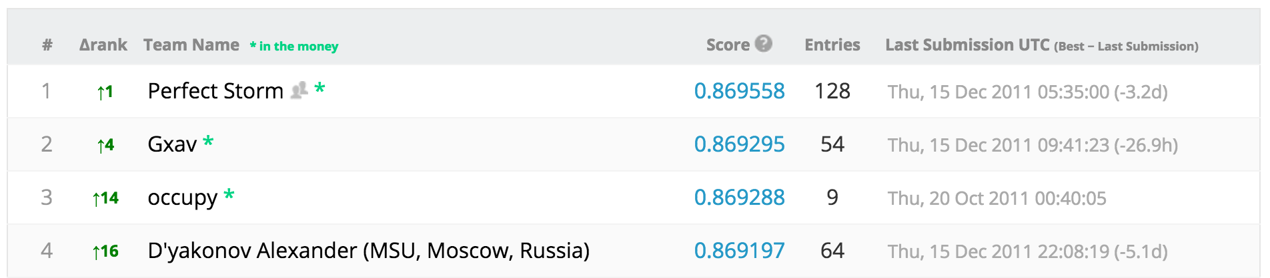
Results Compared to Kaggle
60% training, 20% validation, 10% testing
Regularized logistic regression: 63% AUC
Random forest: 84% AUC

Slide 71
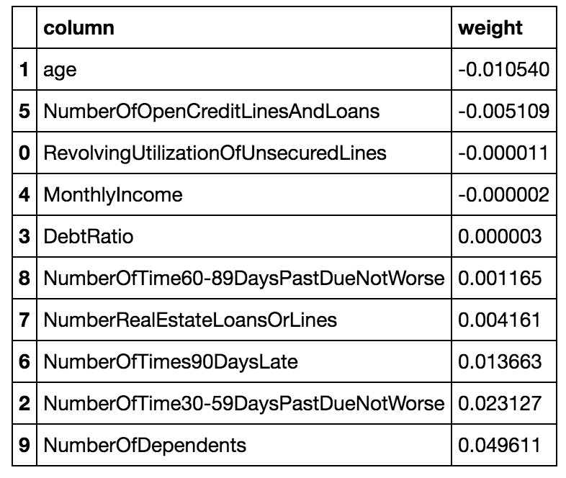
Interpreting fits
Logistic regression: easy

Slide 72
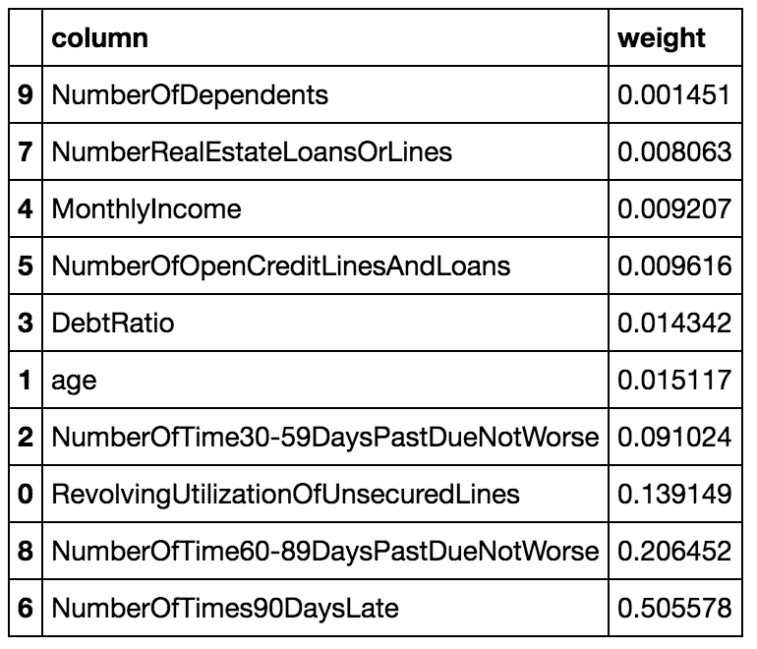
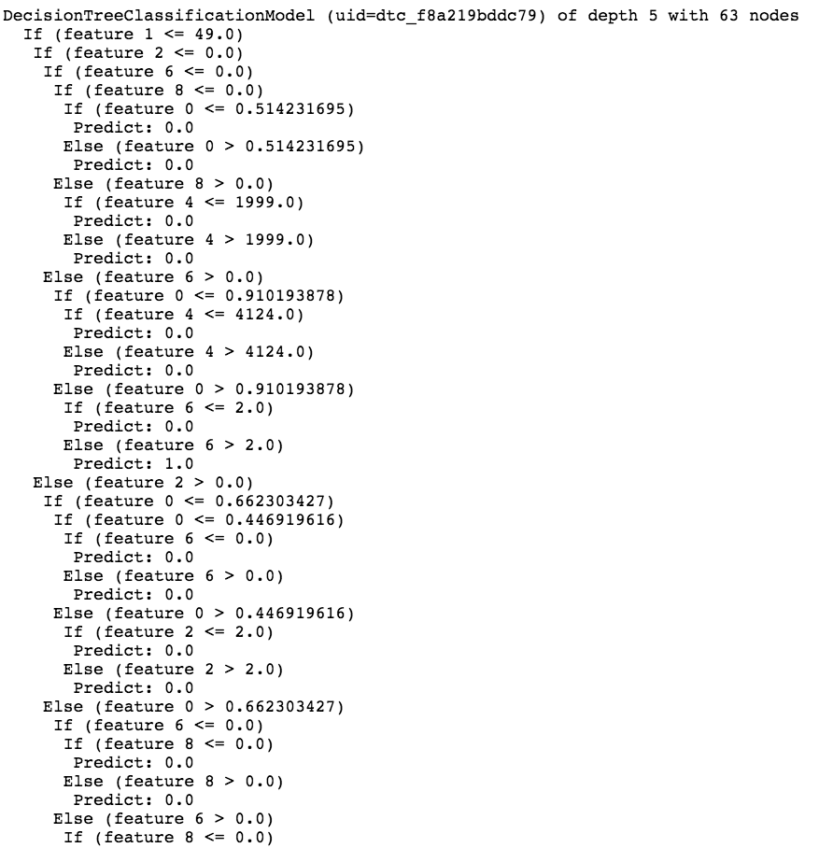
Interpreting fits
Random forest: compute average reduction in entropy across trees
1 out of 20 trees learn. Depth 5, nodes = 65

Slide 73
Attendance
Please fill out the attendance sheet: https://docs.google.com/spreadsheets/d/1G5tiqXQn9mwyubWdINtPI_QONXH1_2U8oYikksgWlss/edit?usp=sharing
Write in a ‘1’ if you are present

